Slide 1
Marketing 341 Realty
Name:
Course:
Institution:
Tutor:

Slide 2
What is Marketing 341 Realty?
Marketing 341 Realty is a private real estate company located in Queens, New York with a main objective of offering real estate and property management services to property owners and real estate investors.
Our zones of operations include:
  Brooklyn
  Queens
  Bronx
  Manhattan
  Long Island.
Our business has a high potential of growing due to factors such as increased population, and the need for consumers to buy or rent houses and apartments.

Slide 3
Mission and Vision Statements
Mission Statement
To offer meaningful and lasting real estate and property management solutions to our customers and inspiring long-lasting relationships.
Vision Statement
To be the leading real estate services provider in New York City.

Slide 4
Services Offered
Marketing 341 Realty offers a variety of services to investors who are seeking to invest in homes, or to migrators who are seeking residential solutions.
Our services include:
  Listing
  Selling
  Property management
Listing involves negotiations with home owners or developers to agree on a marketable rice.
Selling is all about searching for potential buyers and convincing them to buy the house.
Property management includes services such as:
  Maintaining
  Renting
  Signing new lease contracts
  Budgeting and arranging for repairs

Slide 5
SWOT ANALYSIS
New York’s high population
Highly skilled Management Team
User-friendly website and application
Dedicated research and development team
Increasing job growth
Technological advancements
Automation of the back office activities.
Strengths
Opportunities
Large managerial team creating a challenge in office area management.
Inadequate accounting team.
Limited sources of information.
Economic Recession
Competition from established firms.
Unfavorable government regulations such as travel restrictions
Weaknesses
Threats

Slide 6
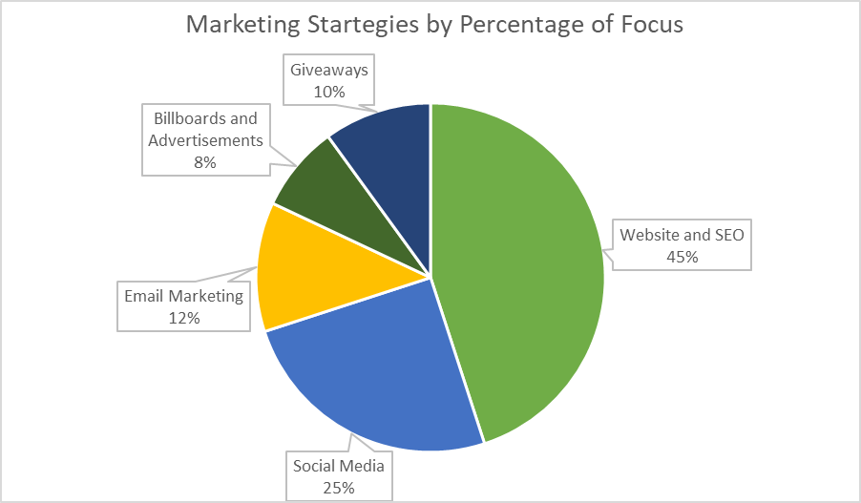
Marketing Strategy
Marketing 341 Realty focuses on creating a robust online presence due to the current trend of internet marketing.
The chart below represents our various marketing strategies and our investments on each:

Slide 7
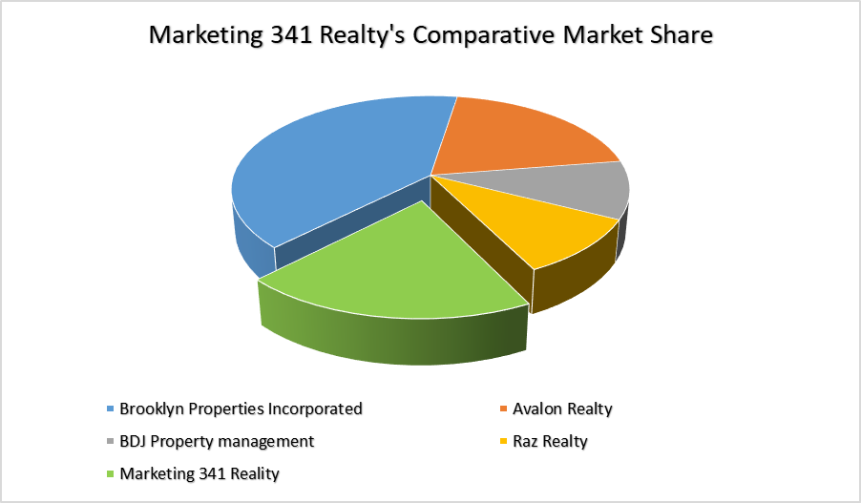
Competition Analysis and Market Share
Due to the increase in population and availability of jobs in New York City, Marketing 341 Realty is guaranteed to easily enter the market.
We expect to command a 20% market share.
Our competition include well established companies such as BJD Property management, and Raz Realty

Slide 8
Keys to Success
Marketing 341 Realty regards some factors with a lot of significance because we believe they will lead to a successful venture.
These factors include:
  Cultivating lasting relationships
  Making connections with our previous clients
  Openness and transparency
  Focus on consultation more than on selling
  Cultivating a heavy online presence.
We believe that when these factors are prioritized, achieving our goals will come automatically.

Slide 9
Sales Forecast
Marketing 341 Realty will use its key factors as defined by our mission and vision statements to drive sales.
  We intend to invest time and finances on conducting robust research on customer needs.
  The staff and management are dedicated and passionate to help homeowners get buyers, and buyers to acquire quality homes.
  Our marketing strategies are dynamic and up to date, to ensure we reach as many customers as possible.
  Marketing 341 Realty also intends to create meaningful and strategic relationships with the communities in the areas of operations.
With such factors in place, our sales are guaranteed to skyrocket and maintain an upward movement for a long time.

Slide 10
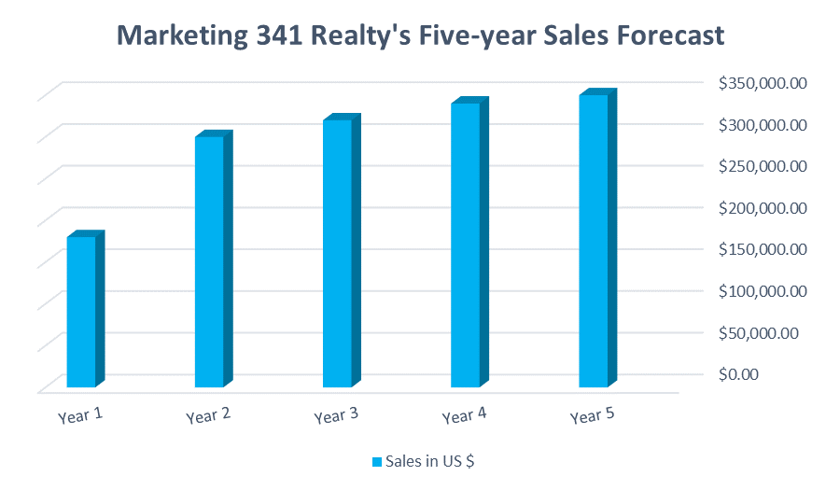
Sales Forecast

Slide 11
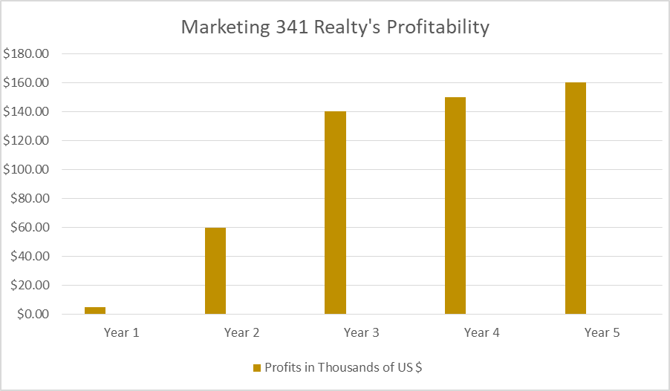
Profit/Loss Analysis

Slide 12
Marketing 341 Realty in a Nutshell
Marketing 341 Realty is a private real estate company located in Queens, New York.
With strengths such as highly-skilled employees and opportunities such as increase in population, the startup is bound to thrive in the ever-growing industry.
The company intends to gain control over 20% of the market through rigorous marketing strategies especially online-related marketing.
Our mission and vision statements which entail inspiring and impacting a lasting relationship will aid in keeping the company strong in the industry.

Slide 13
References
Armstrong, G., Kotler, P., & He, Z. (2005). Marketing: an introduction.
Teicher, H. M. (2018). Practices and pitfalls of competitive resilience: Urban adaptation as real estate firms turn climate risk to competitive advantage. Urban Climate, 25, 9-21.
Obi, N. E., Emoh, F. I., Egolum, C. C., & Ewurum, N. I. (2019). Foreign Direct Investment in Nigeria’s Commercial Real Estate Market: A SWOT Analysis. IOSR Journal of Business and Management (IOSR-JBM), 21(2), 46-56.

